Slide 1
Campus Area Network (CAN)
Under supervision of Professor : Elhosein Ahmed

Slide 2



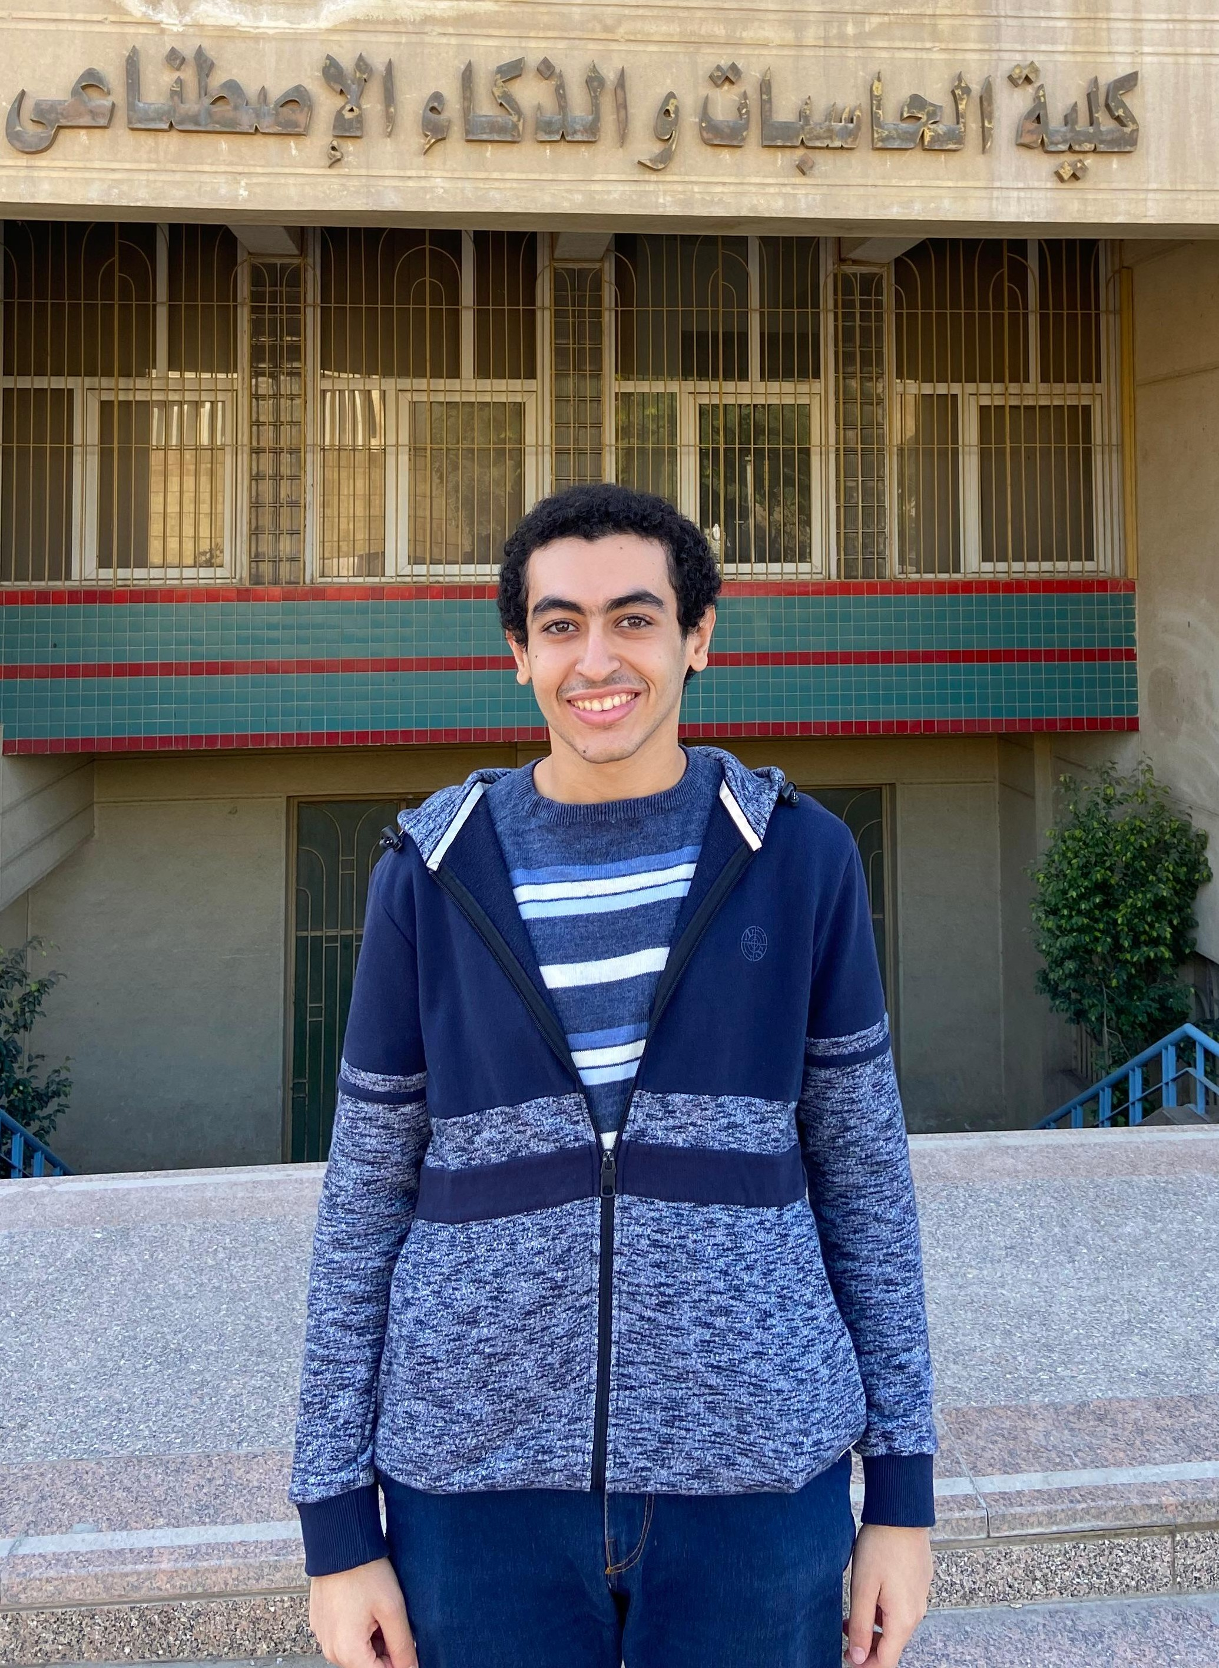


Team Members
Khalid Abdelnaser
Ali Mohamed
Mohamed Omar
Kerolos Maged
Mohamed Karam
Khaled Gamal

Slide 3
Table of contents
01
02
03
05
06
Project
Phases
Introduction
Challenges &
& solutions
04
Future Enhancements
Conclusion
References

Slide 4
01
Introduction

Slide 5
Project overivew
Campus Network Project :
A scalable three-layer design with VLAN segmentation, redundancyprotocols (HSRP, STP), and secure IP addressing to simulate a robust enterprise campus network.
Key goals to achieve
Scalability
Availability
Security

Slide 6
02
Project phases

Slide 7




Project phases
Network design
Network secuirty
Core implementation
Testing & Optimization

Slide 8
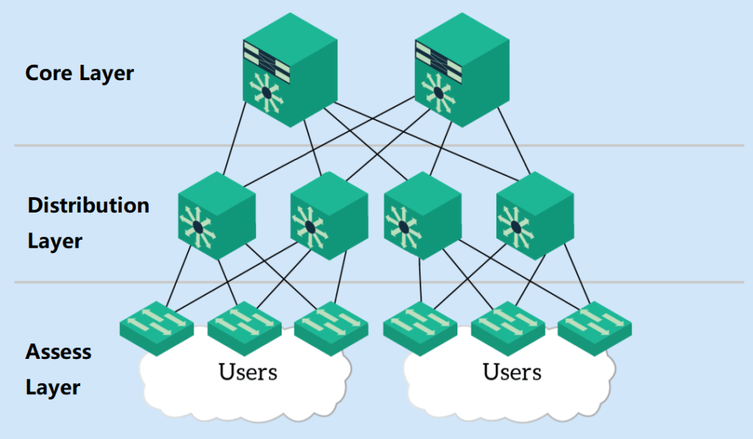

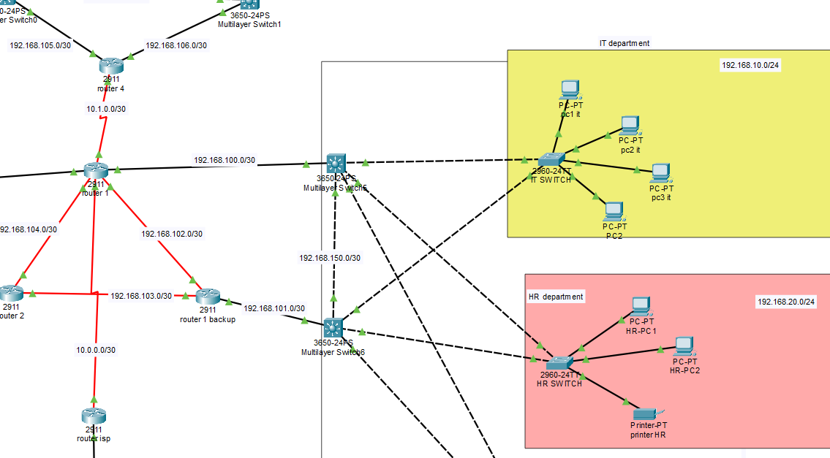
Network design
Network design structures a network for efficient, secure communication. It uses a three-layer model:
Core (fast backbone)
Distribution (routing/control)
Access (user connection)
This ensures performance, scalability, and easy management.

Slide 9
Devices used
PCs
User devices for accessing network services
Multilayer switches
Combine switching and InterVlan routing .
access switches
Connect local devices in the access layer
routers
Link different networks and manage traffic
Servers
Provide shared services (e.g., files, web)

Slide 10
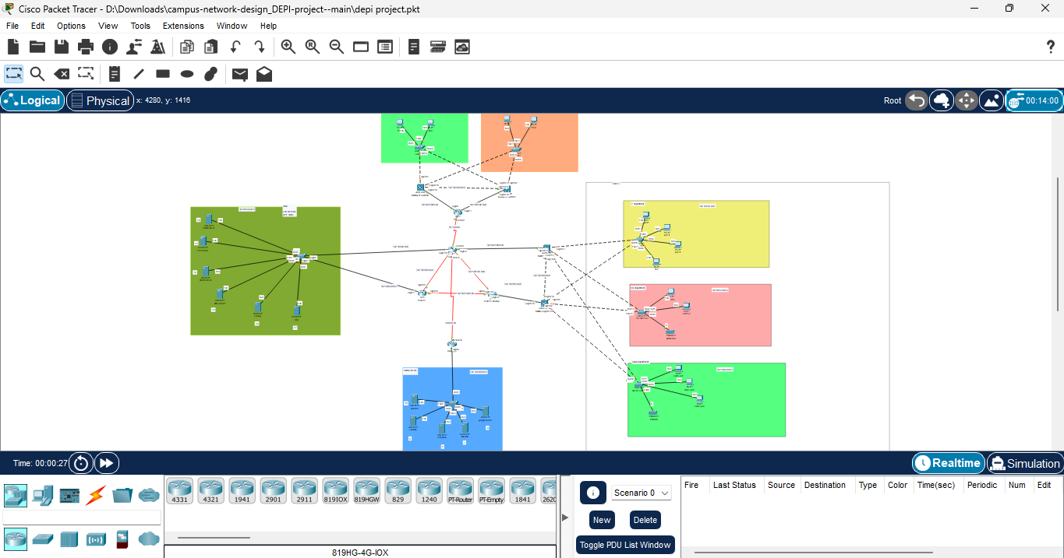
Full network Toplogy

Slide 11
Vlans and thier subnets
Core Implementation
 | Network | Subnet mask | Defult gateway
IT | 192.168.10.0/24 | 255.255.255.0 | 192.168.10.1
HR | 192.168.20.0/24 | 255.255.255.0 | 192.168.20.1
Sales | 192.168.30.0/24 | 255.255.255.0 | 192.168.30.1
Management | 192.168.40.0/24 | 255.255.255.0 | 192.168.40.1
Health & care | 192.168.50.0/24 | 255.255.255.0 | 192.168.50.1

Slide 12



Why we used both Dynamic (OSPF) & Static Routing ? To combine between the advantages of the two routing :
Core Implementation
Static routing advantages
Simple to configure manually
Consumes fewer resources
Dynamic routing advantages
Adapts to network changes
Scales for large networks

Slide 13
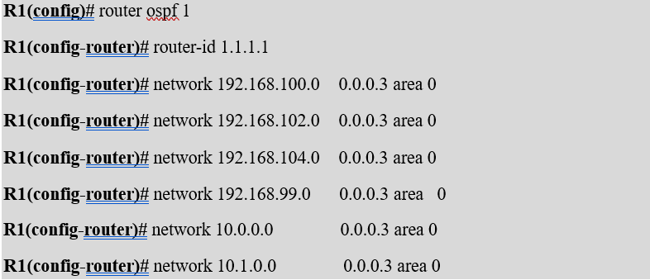
Core Implemention
Core route configuration

Slide 14
Servers used in the project :
DHCP
Automatically assigns IP addresses to devices, easing network management.
Email
Handles sending, receiving, and storing of organizational email traffic.
Syslog
Collects logs from network devices for monitoring and diagnostics.
FTP
Enables file transfers between systems for sharing and centralized storage.
Keeps device clocks Aligned across the network for accurate timing.
Translates domain names into IP addresses for easier access to services.
NTP
DNS

Slide 15
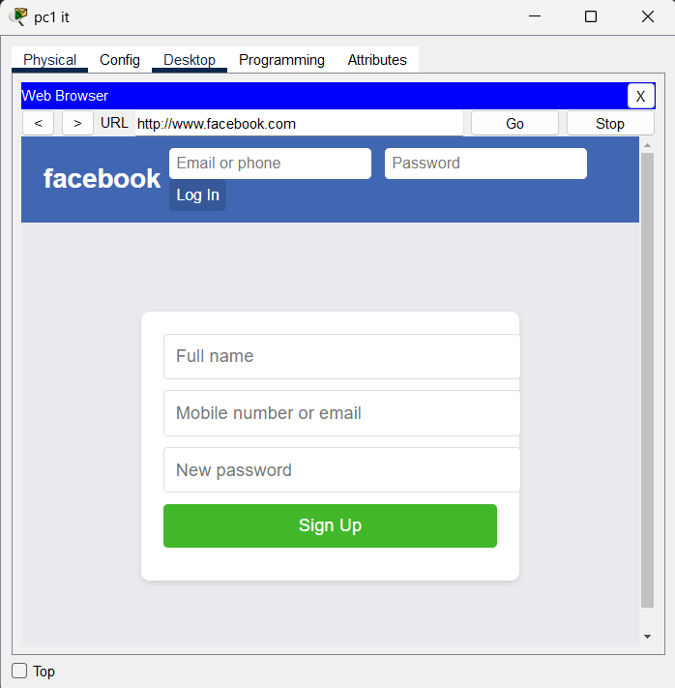
EX of Servers used in the project :

Slide 16

Port security
Port security is a Layer 2 feature that restricts switch port access using MAC addresses.It prevents unauthorized devices from joining the network.Limiting allowed devices per port enhances local access control.It also protects against MAC flooding and spoofing attacks.
Why Using Port Security
Prevents unauthorized device access
Limits number of devices per port
Provides alert or shutdown options on violation

Slide 17

Testing in Network Design
Testing:
tested all device configurations IP addressing,VLANs ,(etc).
Simulated network traffic to ensure stable connectivity.
Verified access between PCs and servers to catch issues early.
Failover:
Implemented redundancy using multiple links and backup paths.
Used multilayer switches for faster internal failover.
Ensured the network stays active during device or link failure.

Slide 18
03
Challenges & solutions

Slide 19

Challenges & Soultions
Scalability → Used VLANs and OSPF for easy expansion.
Broadcast Traffic → VLANs reduced unnecessary broadcasts.
Redundancy → HSRP and STP ensured backup paths.
Security → Used ACLs and VLANs to protect data.
Monitoring → Syslog server helped with centralized logging.

Slide 20
04
Future Enhancements

Slide 21
Future Enhancement
Stronger Security
Add NGFW, IDS for advanced threat protection.
Network Automation
Use tools like Python for config and monitoring.
Cloud Integration
Connect to Azure for storage & scalability.
SDN Implementation
Introduce SDN for smarter traffic control.
AI & ML Integration
Use AI/ML for anomaly detection and performance tuning.

Slide 22
05
Conclusion

Slide 23
Project overview
Campus Area Network (CAN) Design Highlights
Performance & Growth
Easy to manage & scale
Ready for future needs
Fast and stable
connectivity
Network Security
Blocks unauthorized access
ACLs applied
Secures VLAN communication
Redundancy & Uptime
Ensures continuous service
HSRP and STP for failover
Supports seamless failover for critical services.

Slide 24
06
References

Slide 25
References
Cisco networking academy
Abeer Hosny (YouTube)
Link : https://www.netacad.com
Link : Abeer Hosny
Ahmed Yousry (YouTube)
Github Repositry
Link : https://github.com/khaled-abdelnaser
Link : Ahmed Yousry

Slide 26
Thank YOU

